Slide 1

CRYPTOGRAPHY AND STEGANOGRAPHY
Securing and Hiding Information

Slide 2
AGENDA
What is Cryptography?
Types of Cryptography
Applications of Cryptography
What is Steganography?
Types of Steganography
Cryptography vs Steganography
Conclusion

Slide 3
WHAT IS CRYPTOGRAPHY ?
Cryptography is the science of securing information by transforming it into an unreadable format
Ensures confidentiality, integrity, authentication, and non-repudiation
Used in banking, communication, military, and digital security

Slide 4
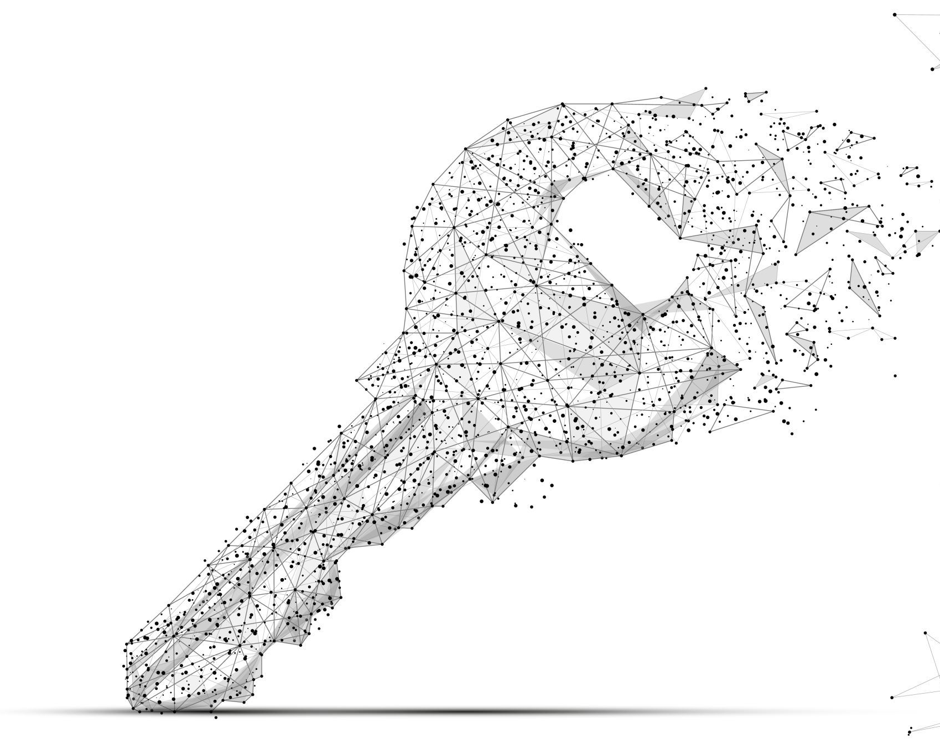
TYPES OF CRYPTOGRAPHY
Symmetric Key Cryptography
Same key for encryption and decryption
Example: AES, DES
Asymmetric Key Cryptography
Public key for encryption, private key for decryption
Example: RSA, ECC

Slide 5
APPLICATIONS OF STEGANOGRAPHY
Steganography is the art of hiding information within other non-secret data
The goal is to conceal the existence of the message
Commonly used in images, audio, video, and text

Slide 6
TYPES OF STEGANOGRAPHY
Image Steganography – Hiding data in image pixels
Audio Steganography – Embedding messages in sound files
Video Steganography – Using video frames to hide data
Text Steganography – Concealing data in text formatting or patterns

Slide 7
CRYPTOGRAPHY vs STEGANOGRAPHY
Feature | Cryptography | Steganography
Purpose | Encrypt data | Hide data
Visibility | Encrypted data is visible | Hidden data is invisible
Detection | Can be detected | Hard to detect
Security Focus | Data protection | Data concealment

Slide 8

CONCLUSION
Cryptography protects the content of the message
Steganography hides the existence of the message
Both are essential in modern digital security and can be used together for enhanced protection

